Slide 1
SISTEMAS OPERATIVOS
SO
E – M 2019

Slide 2
Operating-System Components
Operating-System Components

Slide 3
Process Management
A process is a program in execution. It is a unit of work within the system. Program is a passive entity, process is an active entity.
Process needs resources to accomplish its task
CPU, memory, I/O, files
Initialization data
Process termination requires reclaim of any reusable resources
A process has one program counter specifying location of next instruction to execute
Typically system has many processes, some user, some operating system running concurrently on one or more CPUs
Concurrency by multiplexing the CPUs among the processes

Slide 4
Process Management Activities
The operating system is responsible for the following activities in connection with process management:
Creating and deleting both user and system processes
Suspending and resuming processes
Providing mechanisms for process synchronization
Providing mechanisms for process communication
Providing mechanisms for deadlock handling

Slide 5
Memory Management
To execute a program all (or part) of the instructions must be in memory
All (or part) of the data that is needed by the program must be in memory.
Memory management determines what is in memory and when
Optimizing CPU utilization and computer response to users
Memory management activities
Keeping track of which parts of memory are currently being used and by whom
Deciding which processes (or parts thereof) and data to move into and out of memory (from or to disks)
Allocating and deallocating memory space as needed

Slide 6
Storage Management
OS provides uniform, logical view of information storage
Abstracts physical properties to logical storage unit - file
Each medium is controlled by device (i.e., disk drive, tape drive)
Varying properties include access speed, capacity, data-transfer rate, access method (sequential or random)
File-System management
Files usually organized into directories
Access control on most systems to determine who can access what
OS activities include
Creating and deleting files and directories
Primitives to manipulate files and directories
Mapping files onto secondary storage
Backup files onto stable (non-volatile) storage media

Slide 7
I/O Subsystem
One purpose of OS is to hide peculiarities of hardware devices from the user
I/O subsystem responsible for
Memory management of I/O including buffering, caching, spooling
Drivers for specific hardware controller-devices
General device-driver interface

Slide 8
Computer Systems
Computer Systems (cont.)

Slide 9
Distributed Computer Systems
Distributed Computer System
Collection of separate, possibly heterogeneous, systems (nodes) connected together
Network is a communications path, TCP/IP most common
Local Area Network (LAN) or
Wide Area Network (WAN)
Distributed Operating System provides features between systems across network
Communication scheme allows systems to exchange messages
Sharing of CPUs, RAMs, Disks
The user has no idea where the process is running and which resources is using up
Illusion of a single system

Slide 10
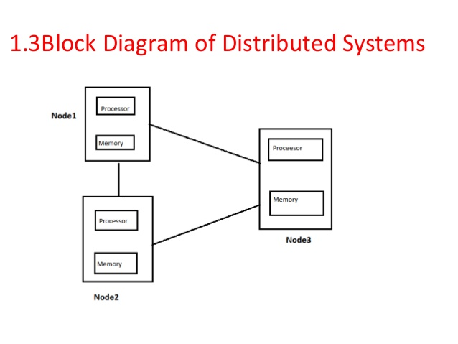
Distributed Computer Systems
CS-a
CS-b
CS-c

Slide 11
Client-Server Computer Systems
Client-Server Computer System
Personal Computers and Mobiles working like clients through browsers that access the servers
Many systems now servers, responding to requests generated by clients
Compute-server system provides an interface to client to request services (i.e. Bank Portals, Amazon, )
File-server system provides interface for clients to store and retrieve files (i.e. Drop Box, One Drive, …)

Slide 12
Real-Time Systems
Often used as a control device in a dedicated application such as controlling scientific experiments, medical imaging systems, industrial control systems, robots and some display systems
Well-defined fixed-time constraints
Critical tasks are completed on time
Utility in industrial control of robotics
Useful in applications (multimedia, virtual reality) requiring tight response times
Conflicts with time-sharing systems, not supported by general-purpose operating systems
Real-Time OS / CS

Slide 13
Operating-System Structures
Operating-System Structures
for services

Slide 14
Operating System Services
Operating systems provide an environment for execution of programs, storage and services to programs and users
One set of operating-system services provides functions that are helpful to the user:
User interface - Almost all operating systems have a user interface (UI).
Varies between Command-Line (CLI), Graphics User Interface (GUI), Batch
Program execution - The system must be able to load a program into memory and to run that program, end execution, either normally or abnormally (indicating error)
I/O operations - A running program may require I/O, which may involve a file on storage or any other I/O device

Slide 15
Operating System Services (cont.)
One set of operating-system services provides functions that are helpful to the user (Cont.):
File-system manipulation - The file system is of particular interest. Programs need to read and write files and directories, create and delete them, search them, list file Information, permission management.
Communications – Processes may exchange information, on the same computer or between computers over a network
Communications may be via shared memory or through message passing (packets moved by the OS)
Error detection – OS needs to be constantly aware of possible errors
May occur in the CPU and memory hardware, in I/O devices, in user program
For each type of error, OS should take the appropriate action to ensure correct and consistent computing
Debugging facilities can greatly enhance the user’s and programmer’s abilities to efficiently use the system

Slide 16
Operating System Services (cont.)
Another set of OS functions exists for ensuring the efficient operation of the system itself via resource sharing
Resource allocation - When multiple users or multiple jobs running concurrently, resources must be allocated to each of them
Many types of resources - CPU cycles, main memory, file storage, I/O devices.
Accounting - To keep track of which users use how much and what kinds of computer resources
Protection and security - The owners of information stored in a multiuser or networked computer system may want to control use of that information, concurrent processes should not interfere with each other
Protection involves ensuring that all access to system resources is controlled
Security of the system from outsiders requires user authentication, extends to defending external I/O devices from invalid access attempts

Slide 17
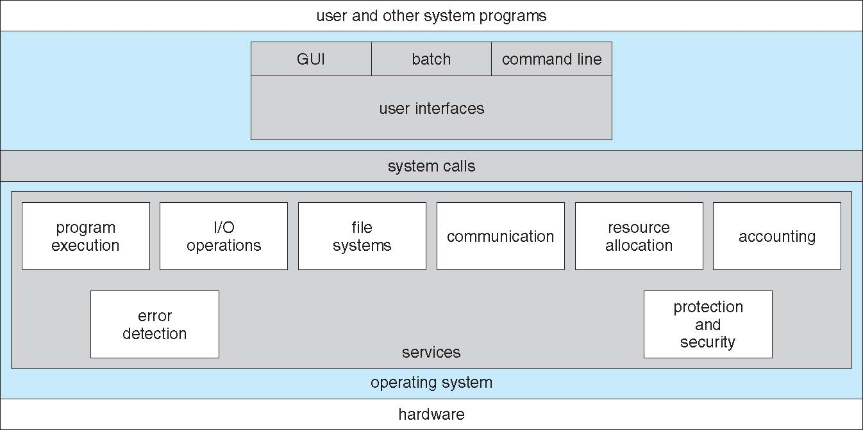
A View of Operating System Services

Slide 18
User Op Sis Interface - CLI
Command-Line Interface (CLI) or command interpreter allows direct command entry
Sometimes implemented in Kernel, sometimes by System Programs
Sometimes multiple flavors implemented – Shells
Primarily fetches a command from user and executes it
Sometimes commands Built-in, sometimes just names of Programs
If the latter, adding new features doesn’t require shell modification
dir, ls, copy, cp
myFirstProgram,

Slide 19
User Op Sys Interface - GUI
User-friendly desktop metaphor interface
Usually mouse, keyboard, and monitor
Icons represent files, programs, actions, etc
Various mouse buttons over objects in the interface cause various actions (provide information, options, execute function, open directory (known as a folder))
Invented at Xerox PARC
Many systems now include both CLI and GUI interfaces
Microsoft Windows is GUI with CLI “command” shell
Apple Mac OS X is “Aqua” GUI interface with UNIX kernel underneath and shells available
Unix and Linux have CLI with optional GUI interfaces (CDE, KDE, GNOME)

Slide 20
System Calls
Programming interface to the services (kernel) provided by the OS
Typically written in a high-level language (C or C++) and then translated to Assembly Language.
Mostly accessed by programs via a high-level Application Programming Interface (API) rather than direct System Call use
Three most common APIs are Win32 API for Windows, POSIX API for POSIX-based systems (including virtually all versions of UNIX, Linux, and Mac OS X), and Java API for the Java virtual machine (JVM)

Slide 21
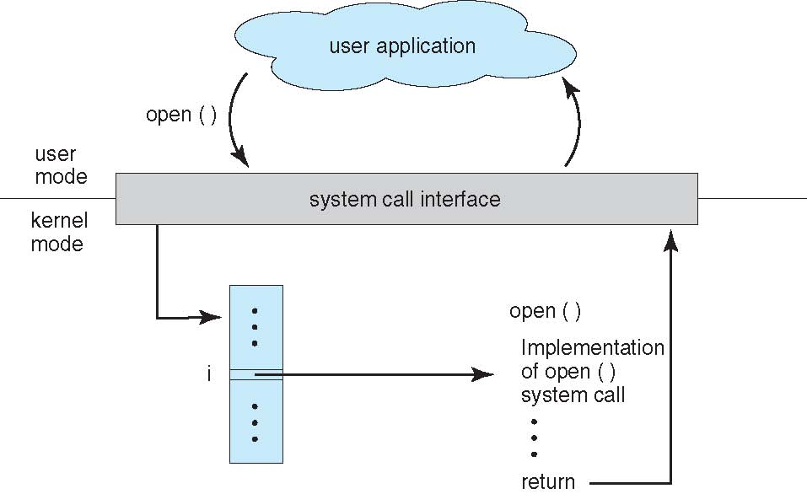
API – System Call – OS
Vector, interrupts

Slide 22
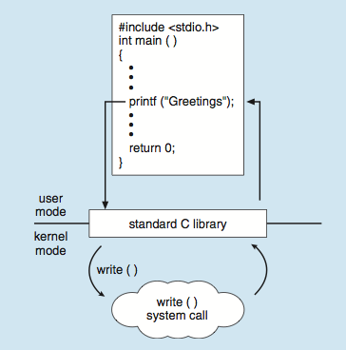
Standard C Library Example
C program invoking printf() library call, which calls write() system call

Slide 23
Types of System Calls to kernel
Process control
create process, terminate process
end, abort
load, execute
get process attributes, set process attributes
wait for time
wait event, signal event
allocate and free memory
Dump memory if error
Debugger for determining bugs, single step execution
Locks for managing access to shared data between processes

Slide 24
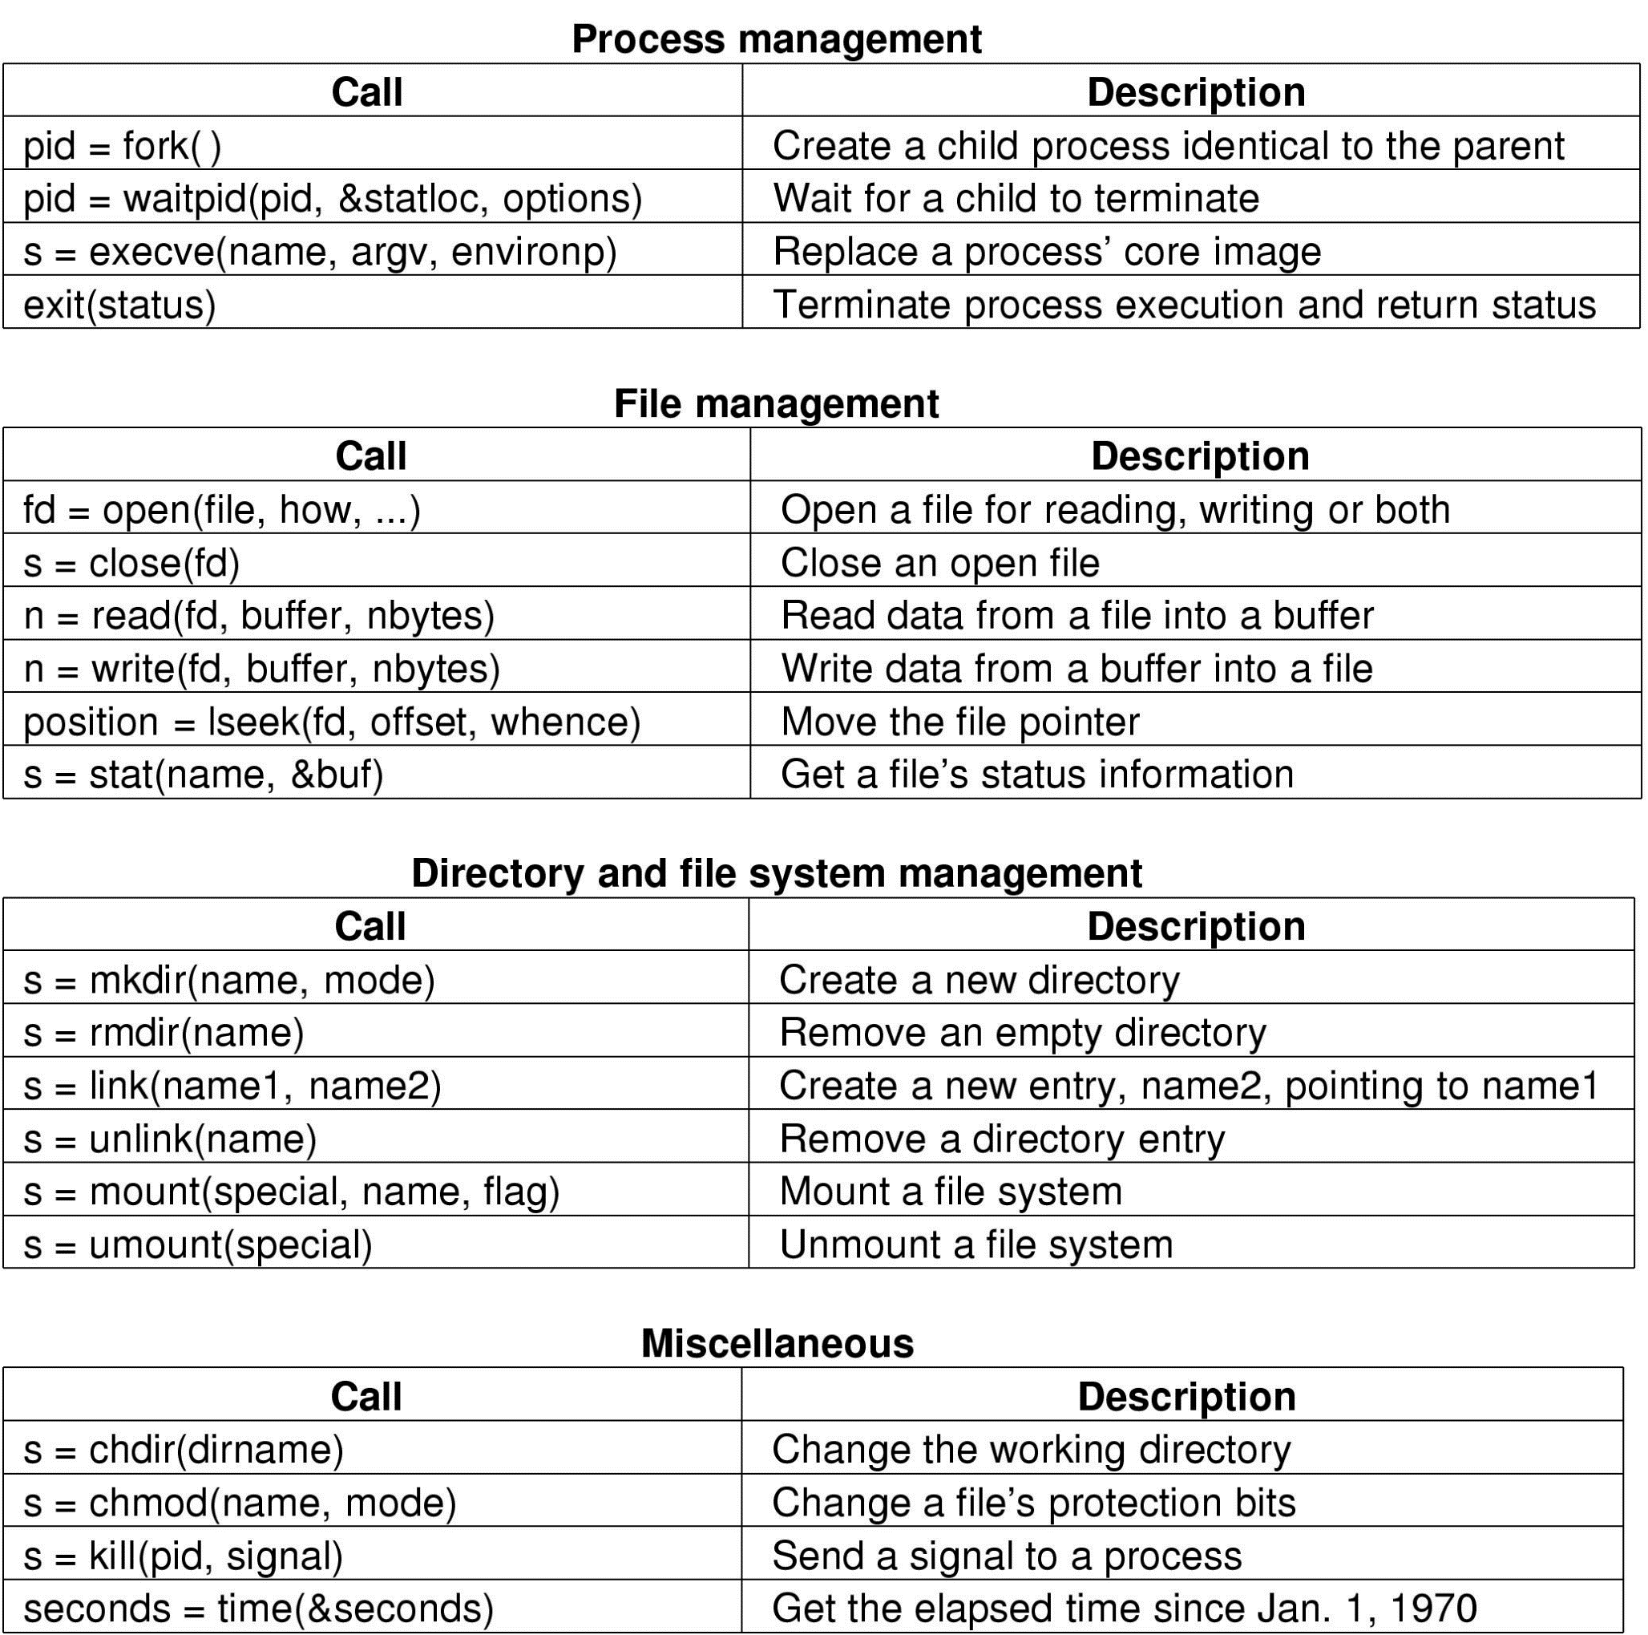
Types of System Calls (cont.)

Slide 25
Types of System Calls (cont.)
File management
create file, delete file
open, close file
read, write, reposition
get and set file attributes

Slide 26
Types of System Calls (cont.)

Slide 27
Types of System Calls (cont.)

Slide 28
Types of System Calls (cont.)
Device management
request device, release device
read, write, reposition
get device attributes, set device attributes
logically attach or detach devices

Slide 29
Types of System Calls (cont.)
Information maintenance
get time or date, set time or date
get system data, set system data
get and set process, file, or device attributes
Communications
create, delete communication connection
send, receive messages if message passing model to host name or process name
From client to server
Shared-memory model create and gain access to memory regions
transfer status information
attach and detach remote devices

Slide 30
Types of System Calls (cont.)
Protection
Control access to resources
Get and set permissions
Allow and deny user access

Slide 31
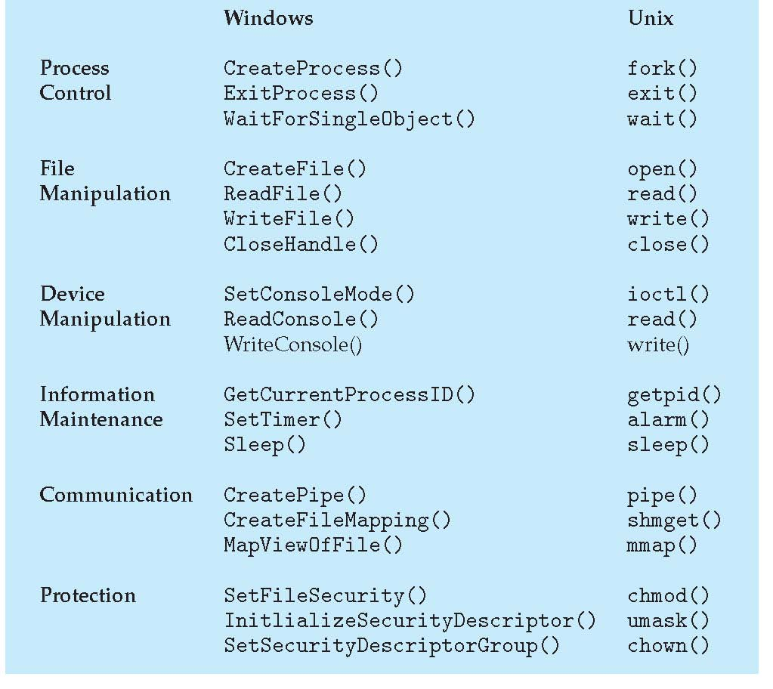
Windows and Unix System Calls

Slide 32
References
Presentación de Ramón Ríos.
Capítulos: Operating System Concepts; Silberschatz, Galvin, Gagne.
31-ene-2019

